Slide 1

Employee Record System
Project members
Jayesh.B.Patil(46)
Amey.A.Ratnaparkhi(51)
Yash.D.Shettigar(58)
Dipak.D.Zad(73)
Guide:-
Prof.Dipti Raut

Slide 2

Introduction
Employees are the backbone of any company therefore their management plays a major role in deciding the success of an organization. Employee Record System (ERS) used to manage the data of the employees such as personal details, categories etc. This system manages Employee record. Employee Record System is a distributed application, developed to maintain the details of employees working in any organization for record purpose also. The ERS has been developed to override the problems prevailing in the practicing manual system. This project aims to simplify the task of maintaining records of the employees of Company & make sure that their information/ data is safe with the organization. To develop a well-designed GUI based system which is easy to understand & easily adaptable to store employee information provides full functional reports to management of Company.

Slide 3
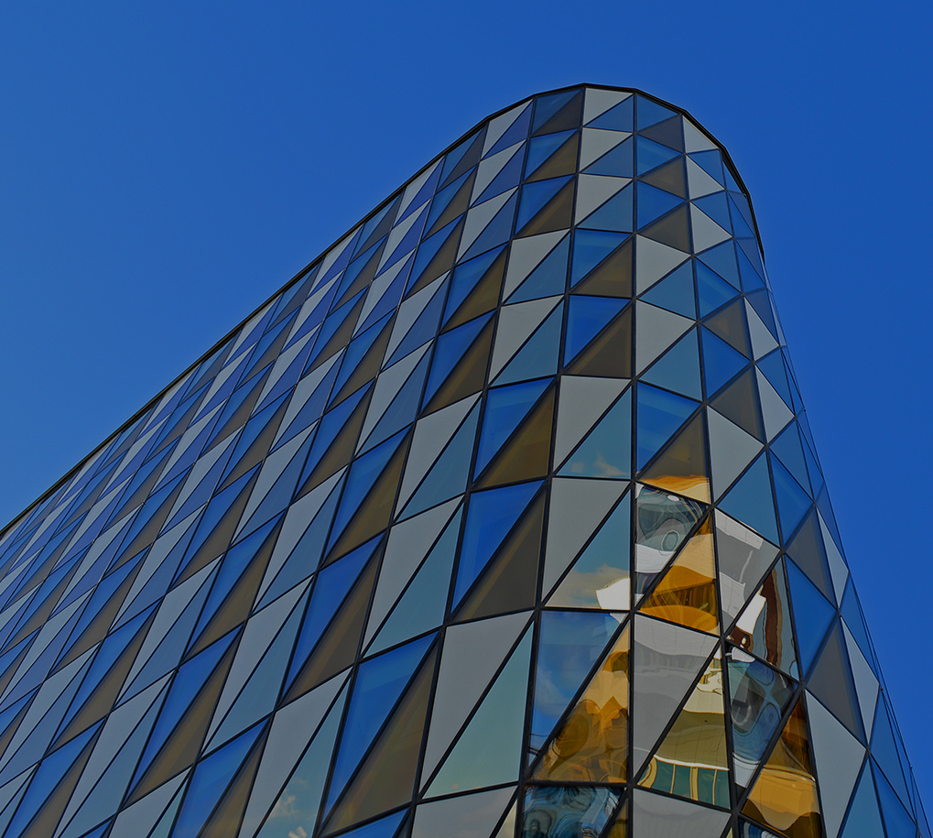
Problem Statement
The Source code of Project has been tested and it is found that it is working and correct, Changes to Project are as Follows:-
Login System Earlier The Project had major security concern, now we have implemented a Secure login access and will protect the employee data
Database Capacity & Securities is improved & increased
New Attributes like blood group, address, phone no & email id
Search action was just displaying the existence of entered employee but now it has gone a full rework now admin can search employee and get full information about them.
New GUI Update New colors and fresh look of the Project

Slide 4

Need Of Employee Record System
Easy to Manage Data in Digital Format.
Time Saving, No Hardwork required.
Employee can be Categorized Easily
Less Paperwork therefore environment friendly.
Details Of Employee can be Searched Faster.

Slide 5
Working
Add Employee Details:
Click on the Employees option located on the left side of the main dashboard. Then, click on the ‘Add Employee’ button, and below employee. Next, you need to add the component details as per the components added to the system.
Remove Employee Details:
If you want to remove the created employee record from the system, you can do so by clicking on the remove option to remove the employee record ,and after clicking on this Enter employee name and surname , after entering the details next click on “click to remove “ option and the record is completely from the system.
Search Employee Details:
Firstly click on search option for Search Employee Details , after that Enter employee name and surname , after entering the details next click on “click to find “ option and the system show Searched employee record from the system.

Slide 6
Feature Of Project
User-Friendly and Complete GUI based
Login System to Protect Record of Employee
Requires less effort for operating data as it is entered through keyboard manually & is cross verified by system also therefore more accurate.
Unlimited life-cycle.
Requires less computing storage & can run in low spec computer system ,therefore efficient system.
It is fast & less time consuming with computations and can manipulate data quickly into the database.

Slide 7
Future Scope
Project can be Converted in Stand-alone .exe application so it can be developed with updates & shared among computer system.
The System can be improved by Proper database using MYSQL for more Security and File safety eg:- corrupt file or OS failure.
Server based File manager can be added to secure from potential data risks.
More Features and operations can be added like Payroll section, attendance section, etc.

Slide 8

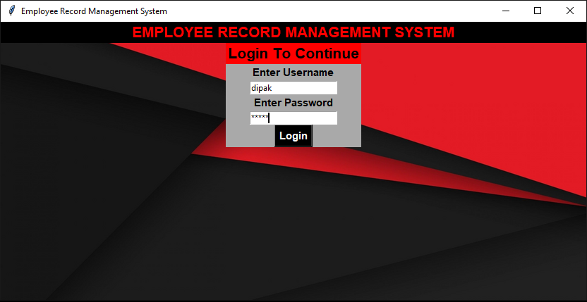
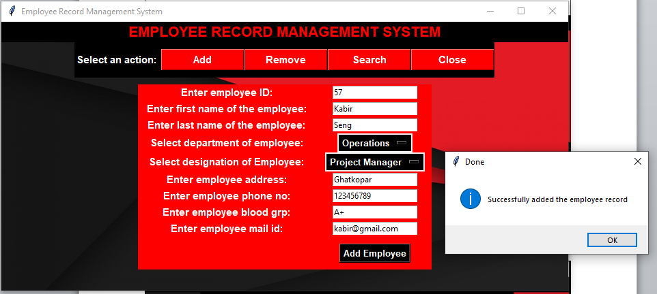
Snapshots
Login page of System
Adding Employee in the database

Slide 9
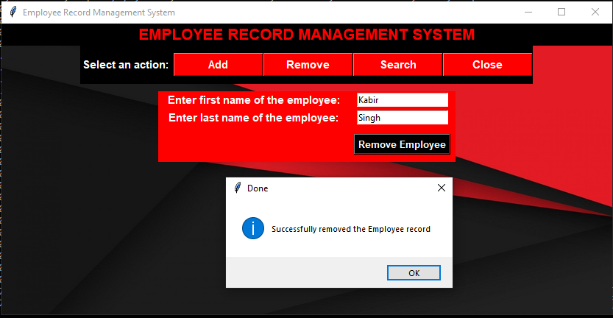
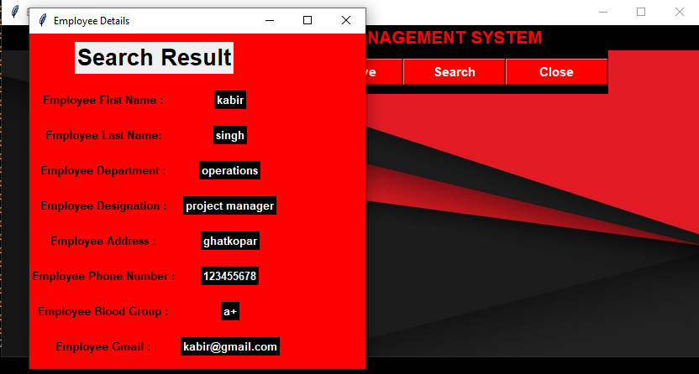
Snapshots
Removing Employee from the database
Searching Employee in the database

Slide 10
ADVANTAGES
GUI based Project so anyone can use it easily.
Requires less effort for operating data as it is entered through keyboard manually & is cross verified also therefore more accurate.
Unlimited life-cycle, as system remains available as long as code remains in the computer system.
Requires less computing storage & can run in low specs. computer system.
It is fast & less time consuming with computations and can manipulate data quickly into the database.

Slide 11
Disadvantages
Future - enhancement is required as it does very few operations.
Very less useful in real time applications.
The system is simple that the output is in a single window only.
It has “.py” file instead of “.exe” file, therefore the source code can be modified.

Slide 12
Conslusion
We have developed this GUI based simple & safe system, to operate all the Employee details/info like Name, designation, etc in safe system by Single click on one platform. This system collects the data and Shows or reflects all the data on one platform and in this system user can add\search\remove the data of the employee by simple steps and keeps the employee details safe in the system.

Slide 13

THANK YOU!

